Slide 1

Advanced Persistent Threats
Citeforma - Lisboa
Formadora:
Manuela Barbosa
Formandos:
Andreia Pereira
João Madeira
20 Dezembro 2022

Slide 2
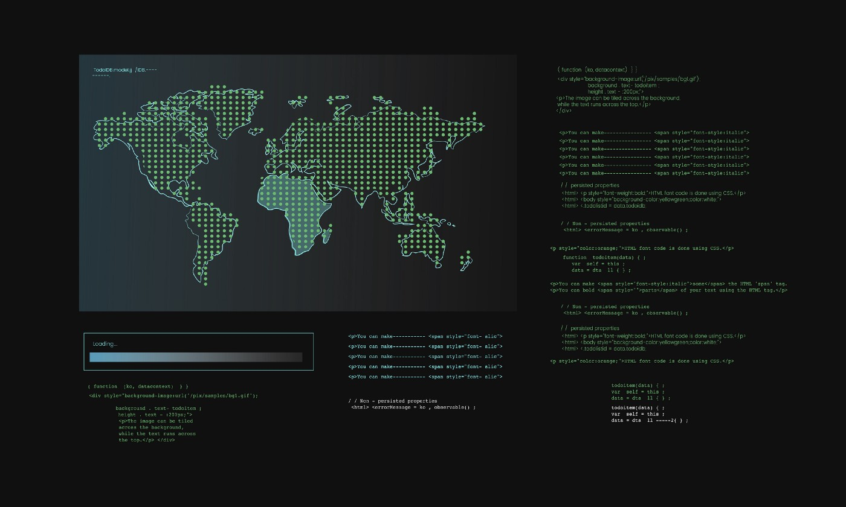
Objetives
What are APTs
Caracteristics
Kill chain
Examples
How to Avoid Them
Notes:
Pergunta introdutória: What do you know abou t APTs? Have your ever heard of that before?
Can you give us some exemples of APTs that you know?

Slide 3
APT DEFINITION

Slide 4

Advanced
Creative
Type of victims
Type of attacks
Attitude
Notes:
Sophisticated attack techniques and exploits, in a creative way
Victims are usually Governments, hospitals, financial institutions
Write their own exploits
Chain together multiple zero-days in a single attack
Don’t hide the attack after done

Slide 5

Persistent
Keep trying
Patient and silently
Distinguish gains
Notes:
Attacker will keep trying until he succeeds
Able to distinguish between short and long term gains; they usually pick the latter to maintain their control and deepen it within the system.

Slide 6
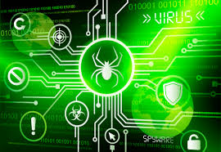
Threats
Motive
Fucosed
Well funded
Notes:
Has a motive
Focused attacks
Orchestrated by a large organization or a well funded group

Slide 7
Characteristics

Slide 8
Characteristics
Purposeful
Risk Tolenrance
Focus on the goal
Resourceful
Multiple Locations
Large Volumes of Traffic
Heavily Funded

Slide 9
Purposeful
Notes:
An ATP as a well defined objective.

Slide 10

Risk Tolerance:
Notes:
Stays hidden
Deepen their control
Until they meet their goals

Slide 11

Focused on goal
Notes:
Not distracted by out of scope
Differentiates itself between short and long term gains

Slide 12
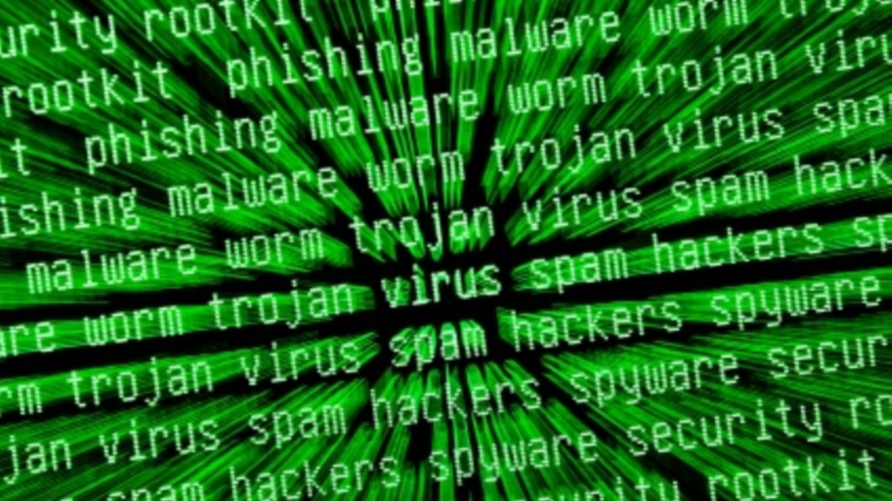
Resourceful
Notes:
Multiple attack vectors; they gather not one source of vulnerabilities within the target they want to attack but many. Cross information between multiple sources.
Creative attacks, outside the box thinking and always evolving

Slide 13
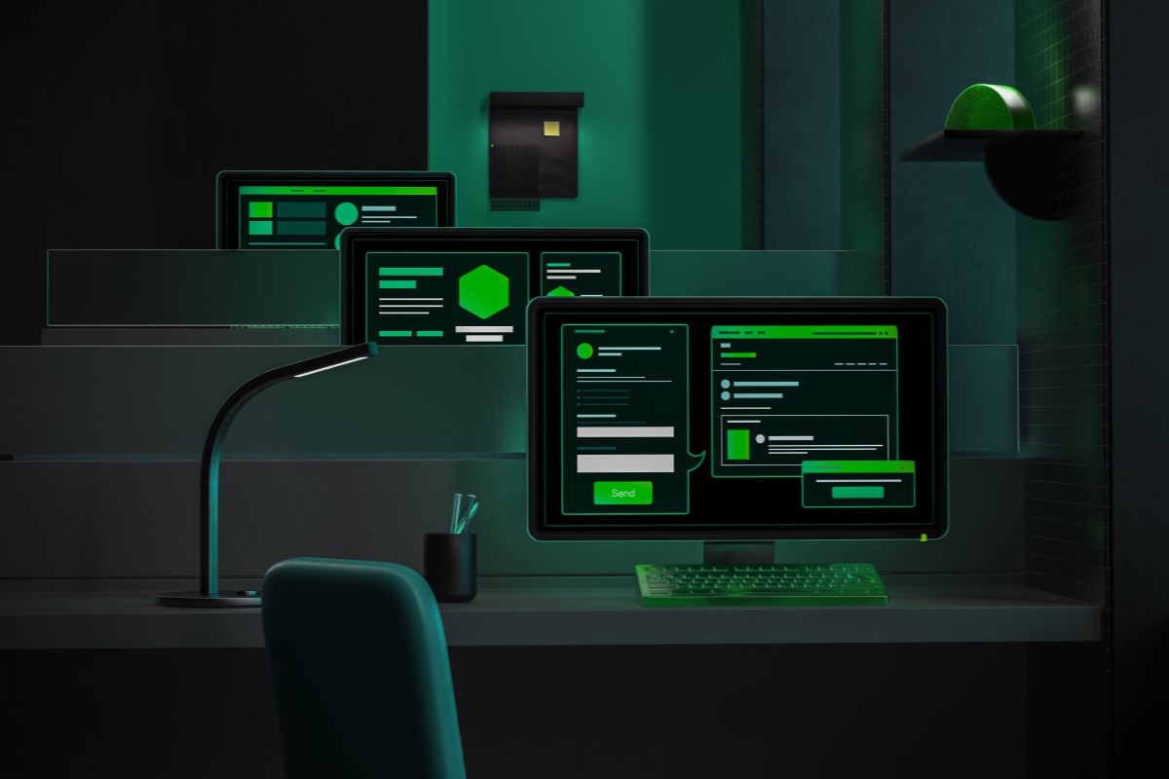
Multiple Locations
Notes:
The victim is targeted in their multiple locations

Slide 14

Large Volumes of Traffic
Notes:
These attacks usually have massive coded viruses and threats to help them achieve what they want.

Slide 15

Heavily Funded
Notes:
Usually government sponsored attacks, though not exclusive

Slide 16
Review

Slide 17
APT - Definition
Advanced
Creative
Type of attacks
Persistent
Keep trying
Patient
Threat
Has a motive
Well funded

Slide 18
Characteristics
Purposeful
Defined objetive
Risk Tolenrance
Stays hidden
Focus on the goal
Not distracted
Resourceful
Multiple attack vectors
Multiple Locations
Where the attack occurs
Large Volumes of Traffic
Massive coded
Heavily Funded
Organizations

Slide 19
Kill Chain
Notes:
What is the kill chain?

Slide 20
How: Kill Chain
Phase 0: Target definition
Phase 1: Intrusion
Phase 2: Further Capture and Persistence
Phase 3: Internal enumeration (Half-stage)
Phase 4: Data Exfiltration
Phase 5: Attack completion

Slide 21

Phase 0
Target definition
Notes:
Choosing a target : focus attention; choose attack vectors

Slide 22

Phase 1
Intrusion
Notes:
First detectable stage
Likely utilize multiple vectors: social engineering, phishing, exploiting zero-days

Slide 23

Phase 2
Further Capture and Persistence
.
Notes:
Backups within the system: to ensure persistence
Elevating Administration Status: to keep exploiting the system

Slide 24

Phase 3
Internal Enumeration
Notes:
Locating information to achieve goals
Collect data: internal networking information; security policies; trust-based relationships.
Example: Pivoting: a technique used by the pen-testers that utilizes a compromised system to attack other different systems on the same network to dodge limitations
A ‘foothold’ to have the option to move around inside a network. Fundamentally utilizing the main compromised system to permit and even guide in the exploit of others, in any case, blocked off systems. For instance, if an attacker hacks a web server on a corporate network, the aggressor would then be able to utilize the compromised web server to attack other different systems on the network. These kinds of attacks are frequently called multi-layered attacks.

Slide 25
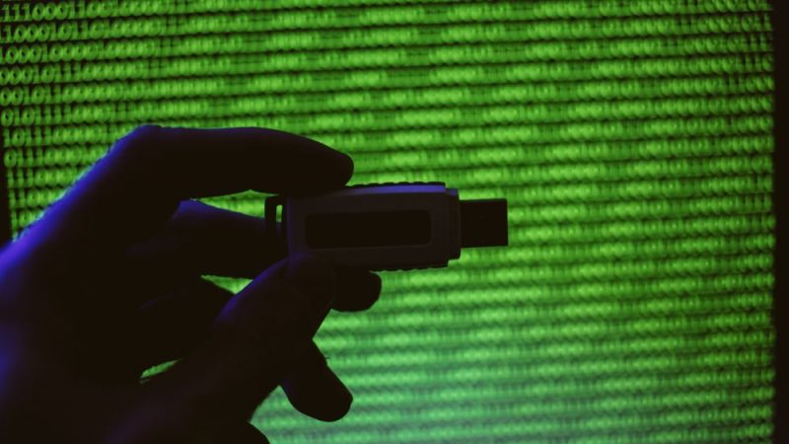
Phase 4
Data Exfiltration
Notes:
The use of VPNs to keep hidden
Data Encapsulation
Use Unpatched Vulnerabilities

Slide 26

Phase 5
Attack Completion
Notes:
The damage done and the data has already been totally compromised
Maintaining the attack hidden and silent to further collect more data or keep the attacker untraceable

Slide 27
Review

Slide 28
Review
Kill Chain
https://youtu.be/TNb8zlHTPgI
Notes:
The damage done and the data has already been totally compromised
Maintaining the attack hidden and silent to further collect more data or keep the attacker untraceable

Slide 29
Examples

Slide 30

Notorious ATPs
FinFisher/FinSpy
Stuxnet
Operation Red October or Red October
Notes:
Stuxnet: Elaborated government funded and first of its kind attack. To this day still studied as a fine example of the sophistication, well coded and ingenious attack.
Operation Red October or Red October: was a cyberespionage malware program discovered in October 2012 and uncovered in January 2013 by Russian firm Kaspersky Lab. The malware was reportedly operating worldwide for up to five years prior to discovery, transmitting information ranging from diplomatic secrets to personal information, including from mobile devices. The primary vectors used to install the malware were emails containing attached documents that exploited vulnerabilities in Microsoft Word and Excel. Later, a webpage was found that exploited a known vulnerability in the Java browser plugin. Red October was termed an advanced cyberespionage campaign intended to target diplomatic, governmental and scientific research organizations worldwide.
FinFisher can be covertly installed on targets' computers by exploiting security lapses in the update procedures of non-suspect software. Dubious legality, the company that made FinFisher possible has been criticized by human rights organizations for selling these capabilities to repressive or non-democratic states known for monitoring and imprisoning political dissidents.

Slide 31

Notorious ATPs
FinFisher/FinSpy
Notes:
Stuxnet: Elaborated government funded and first of its kind attack. To this day still studied as a fine example of the sophistication, well coded and ingenious attack.
Operation Red October or Red October: was a cyberespionage malware program discovered in October 2012 and uncovered in January 2013 by Russian firm Kaspersky Lab. The malware was reportedly operating worldwide for up to five years prior to discovery, transmitting information ranging from diplomatic secrets to personal information, including from mobile devices. The primary vectors used to install the malware were emails containing attached documents that exploited vulnerabilities in Microsoft Word and Excel. Later, a webpage was found that exploited a known vulnerability in the Java browser plugin. Red October was termed an advanced cyberespionage campaign intended to target diplomatic, governmental and scientific research organizations worldwide.
FinFisher can be covertly installed on targets' computers by exploiting security lapses in the update procedures of non-suspect software. Dubious legality, the company that made FinFisher possible has been criticized by human rights organizations for selling these capabilities to repressive or non-democratic states known for monitoring and imprisoning political dissidents.

Slide 32
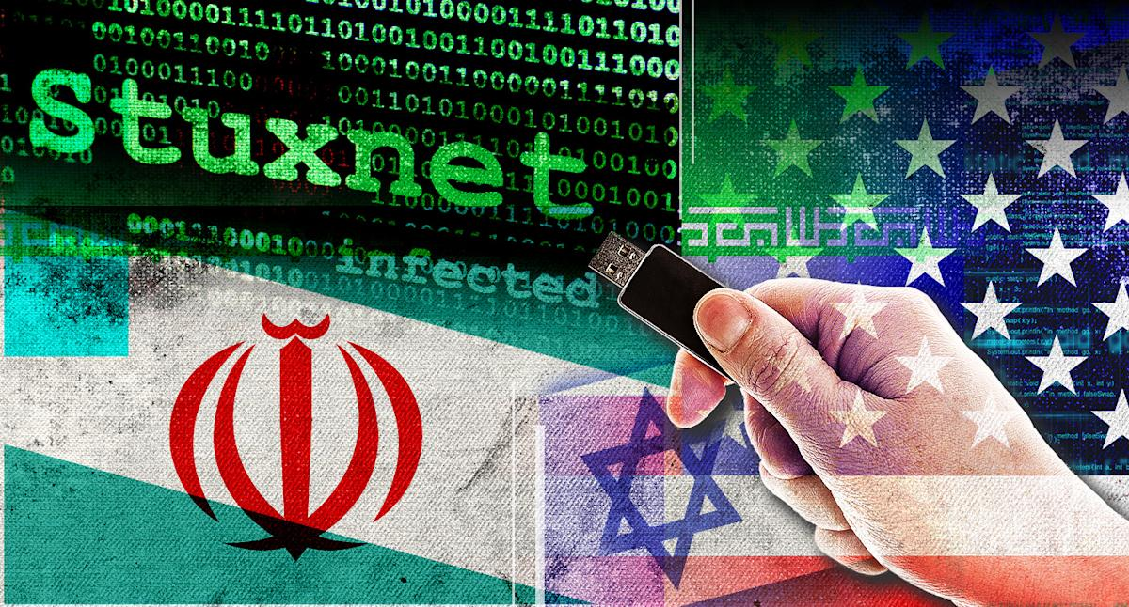
Notorious ATPs
Stuxnet
Notes:
Stuxnet: Elaborated government funded and first of its kind attack. To this day still studied as a fine example of the sophistication, well coded and ingenious attack.
Operation Red October or Red October: was a cyberespionage malware program discovered in October 2012 and uncovered in January 2013 by Russian firm Kaspersky Lab. The malware was reportedly operating worldwide for up to five years prior to discovery, transmitting information ranging from diplomatic secrets to personal information, including from mobile devices. The primary vectors used to install the malware were emails containing attached documents that exploited vulnerabilities in Microsoft Word and Excel. Later, a webpage was found that exploited a known vulnerability in the Java browser plugin. Red October was termed an advanced cyberespionage campaign intended to target diplomatic, governmental and scientific research organizations worldwide.
FinFisher can be covertly installed on targets' computers by exploiting security lapses in the update procedures of non-suspect software. Dubious legality, the company that made FinFisher possible has been criticized by human rights organizations for selling these capabilities to repressive or non-democratic states known for monitoring and imprisoning political dissidents.

Slide 33
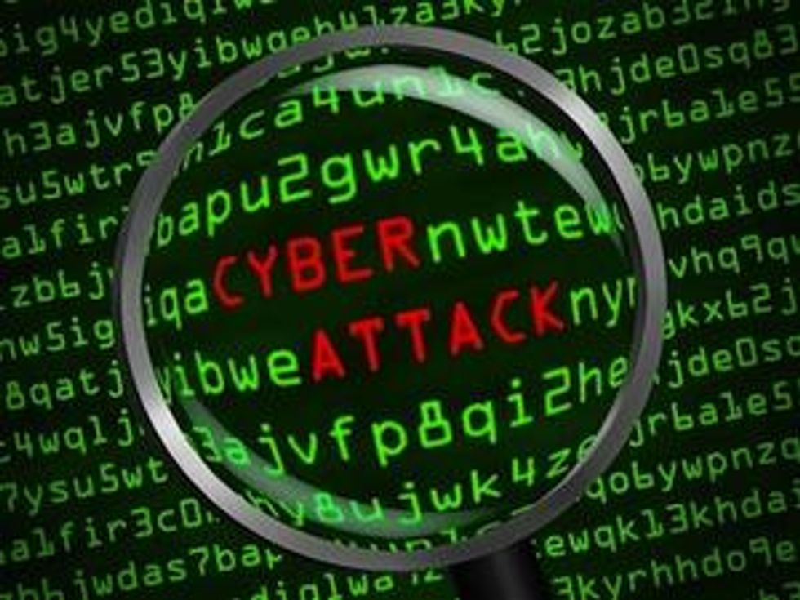
Notorious ATPs
Operation Red October or Red October
Notes:
Stuxnet: Elaborated government funded and first of its kind attack. To this day still studied as a fine example of the sophistication, well coded and ingenious attack.
Operation Red October or Red October: was a cyberespionage malware program discovered in October 2012 and uncovered in January 2013 by Russian firm Kaspersky Lab. The malware was reportedly operating worldwide for up to five years prior to discovery, transmitting information ranging from diplomatic secrets to personal information, including from mobile devices. The primary vectors used to install the malware were emails containing attached documents that exploited vulnerabilities in Microsoft Word and Excel. Later, a webpage was found that exploited a known vulnerability in the Java browser plugin. Red October was termed an advanced cyberespionage campaign intended to target diplomatic, governmental and scientific research organizations worldwide.
FinFisher can be covertly installed on targets' computers by exploiting security lapses in the update procedures of non-suspect software. Dubious legality, the company that made FinFisher possible has been criticized by human rights organizations for selling these capabilities to repressive or non-democratic states known for monitoring and imprisoning political dissidents.

Slide 34
Prevention

Slide 35
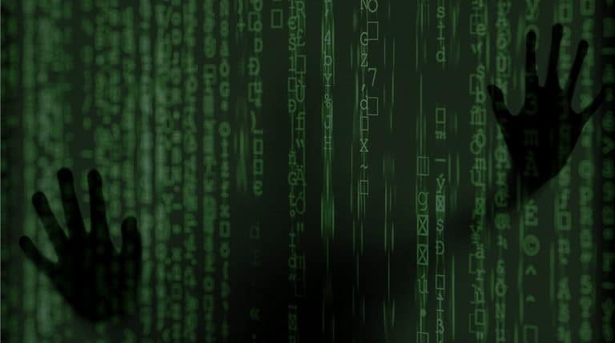
How to Avoid an ATP
Notes:
Regularly patched (Against zero day vulnerabilities)
Well trained employees (Against social engineering attacks)

Slide 36
Conclusion

Slide 37

Conclusão
Notes:
We only know about some of these threats because they were discovered
Sometimes we don’t even know who’s behind these attacks, until the perpetrators acknowledge it. There are still APTs active since their inception. Example: FinSpy. Even though these attacks are massively expensive, anyone can in theory buy and use it, with enough funds and knowledge.
The types of attacks are always evolving and sometimes are very wide in their attacks or specific like Stuxnet
They are a minuscule part of the cyber attacks but they are the most successful and cause the most damage when and if they are found.
The attackers use a variety of vectors to ensure success
The attackers are patient and dedicated. They keep their attacks silent. They know the long term and short term gains of their attacks.
At some point, your organization will be attacked
The bigger the organization, the more valuable it is.

Slide 38
Questions

Slide 39
Thank you!

